Slide 1


Slide 2
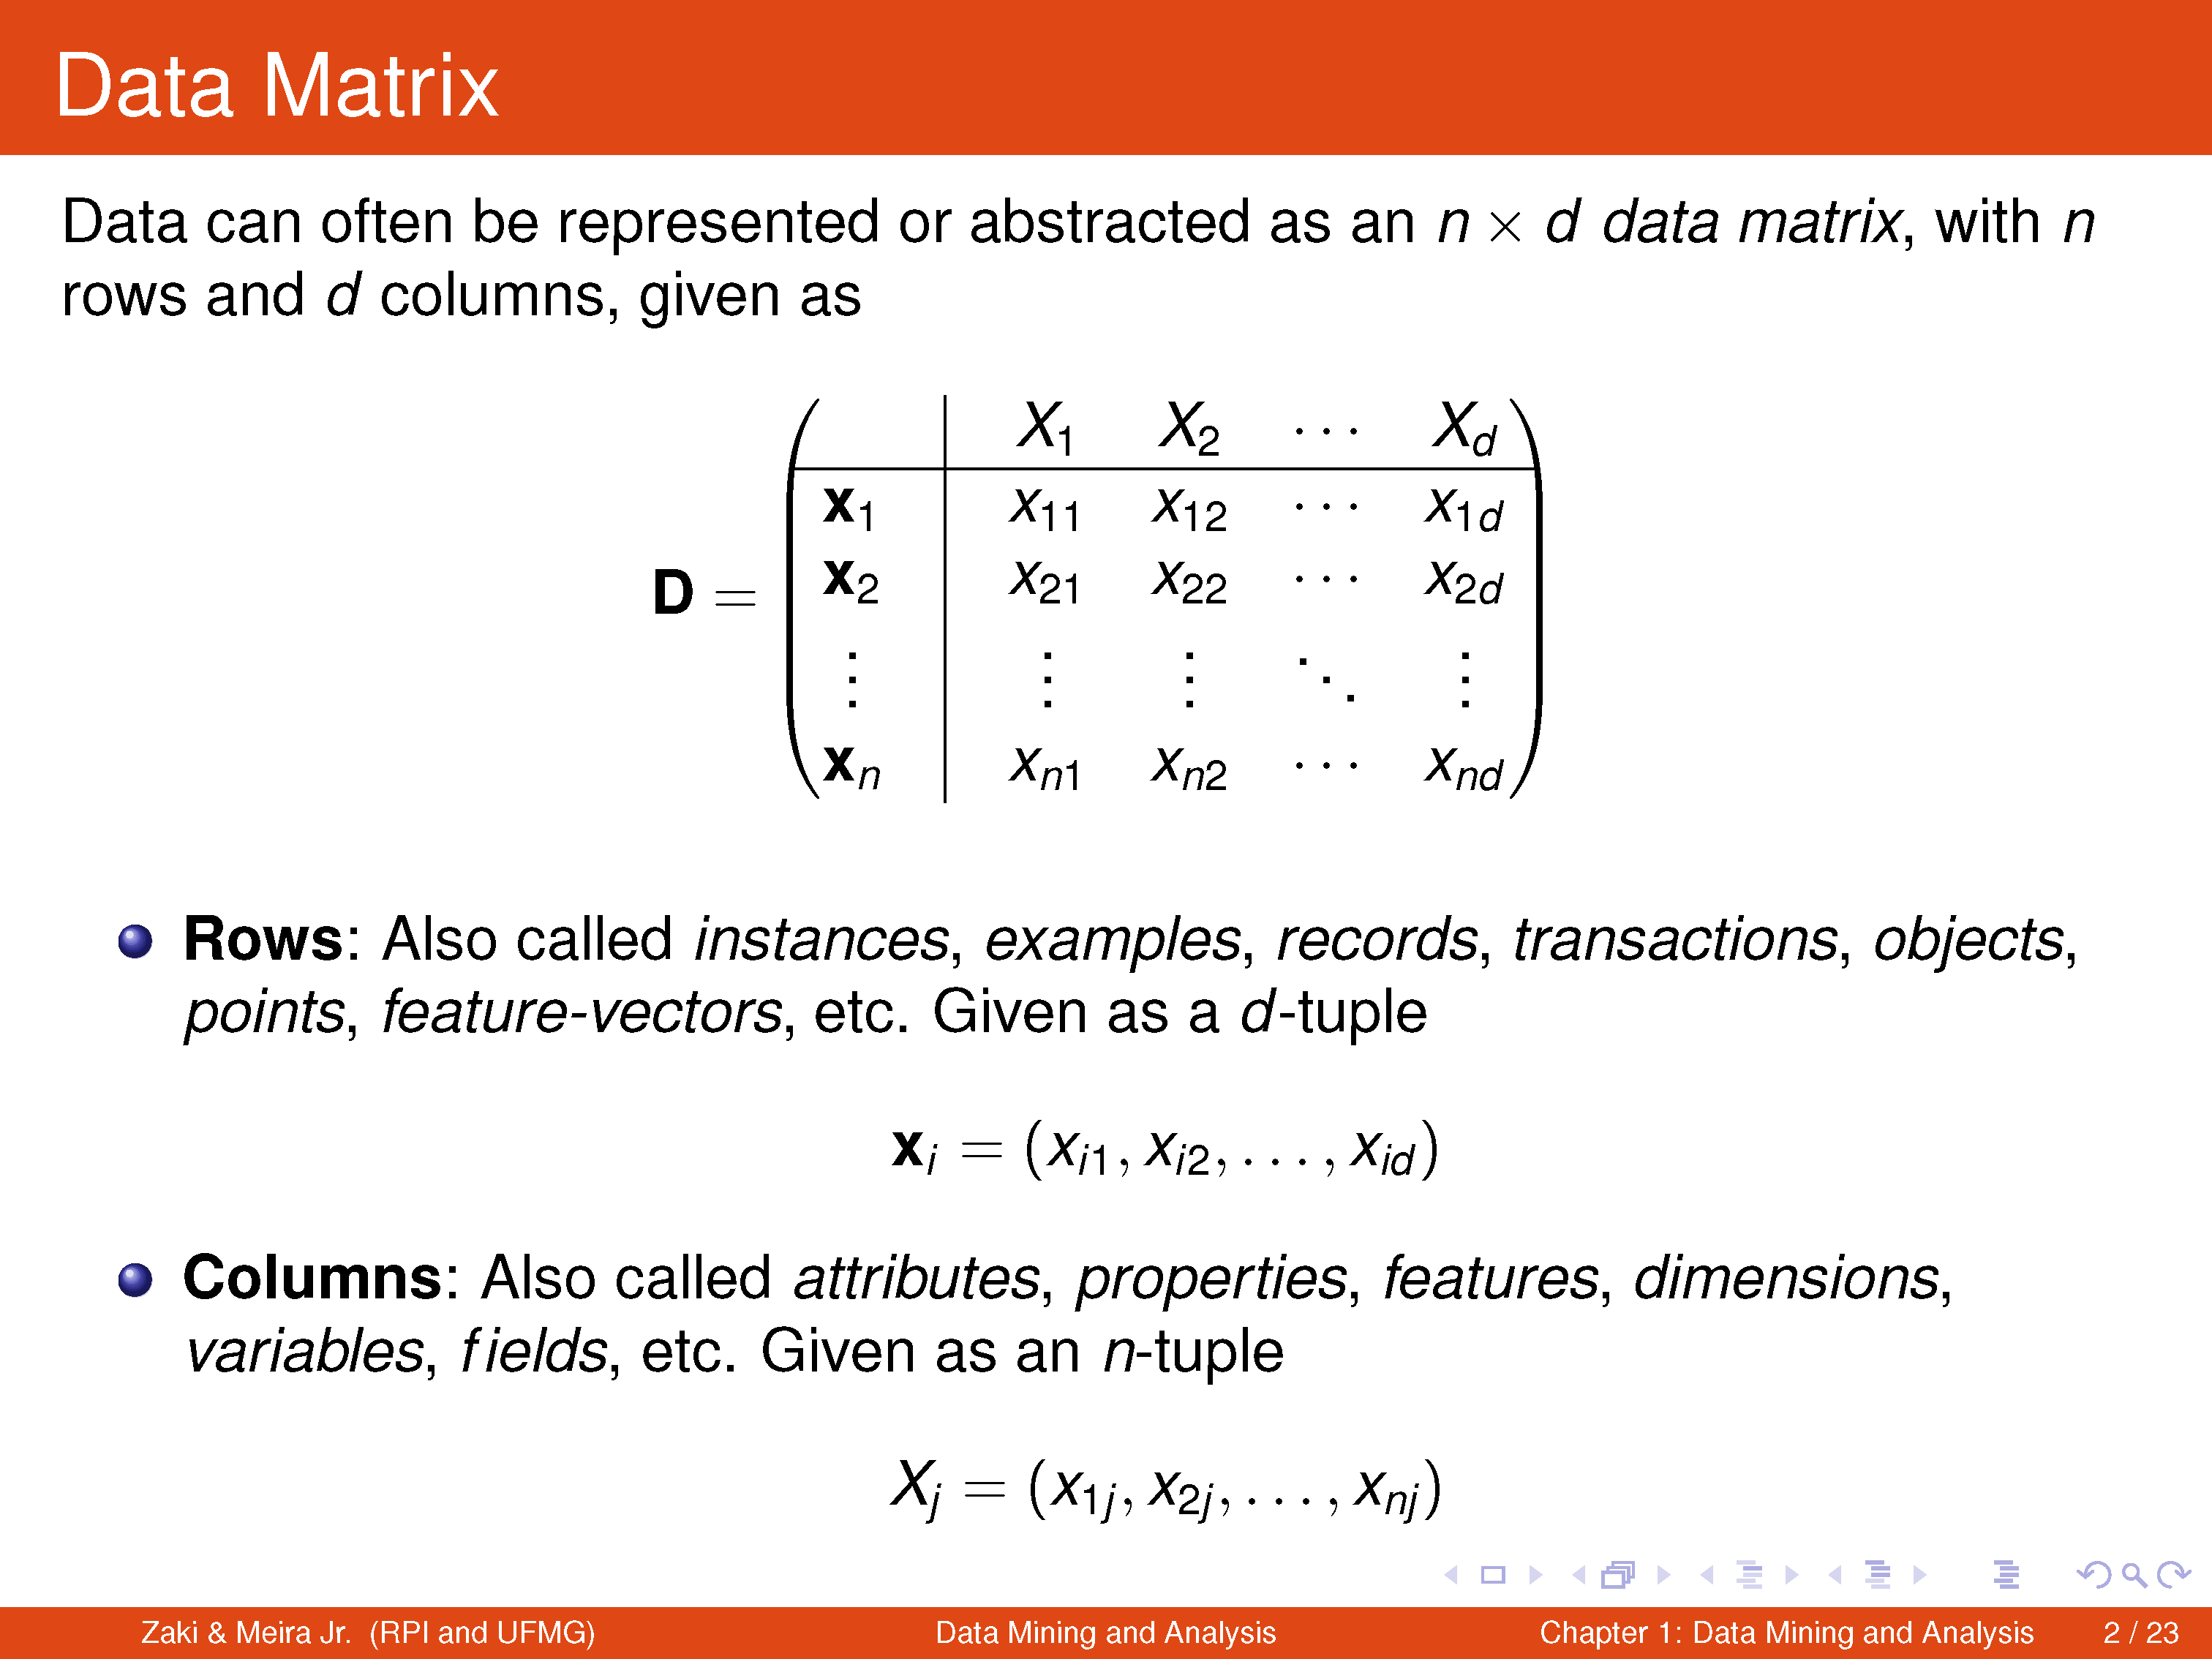

Slide 3
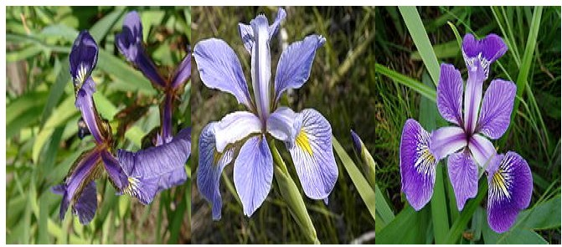
Tribute to Sir Ronald Aylmer Fisher
R. A. Fisher

Slide 4
R. A. Fisher
Statistician
Evolutionary Biologist
Geneticist
The Iris flower data set or Fisher's Iris data set
Sepal Length, Sepal Width, Petal L, Petal W, Species
The morphologic variation of Iris flowers of three related species.

Slide 5
The Fisher's Iris Flower Data Set Sir Ronald Fisher (1936) as an example of discriminant analysis
 | Sepal Length | Sepal Width | Petal Length | Petal Width | Class
 | X1 | X2 | X3 | X4 | X5
x1 | 6.2 | 3.6 | 4.4 | 1.5 | Iris-Versicolor
x2 | 6.9 | 1.0 | 1.1 | 1.6 | Iris-Versicolor
x3 | 3.3 | 1.6 | 1.4 | 1.5 | Iris-Versicolor
x4 | 4.0 | 2.9 | 3.2 | 0.4 | Iris-Setosa
x5 | 4.5 | 1.5 | 1.0 | 1.0 | Iris-Versicolor
x6 | 4.4 | 2.9 | 5.4 | 0.3 | Iris-Setosa
x7 | 4.7 | 1.7 | 5.0 | 0.4 | Iris-Virginica
… | … | … | … | … | …
x148 | 5.7 | 3.4 | 1.2 | 1.1 | Iris-Setosa
x149 | 3.0 | 3.7 | 1.1 | 1.7 | Iris-Virginica
x150 | 6.3 | 3.2 | 5.6 | 1.3 | Iris-Virginica

Slide 6
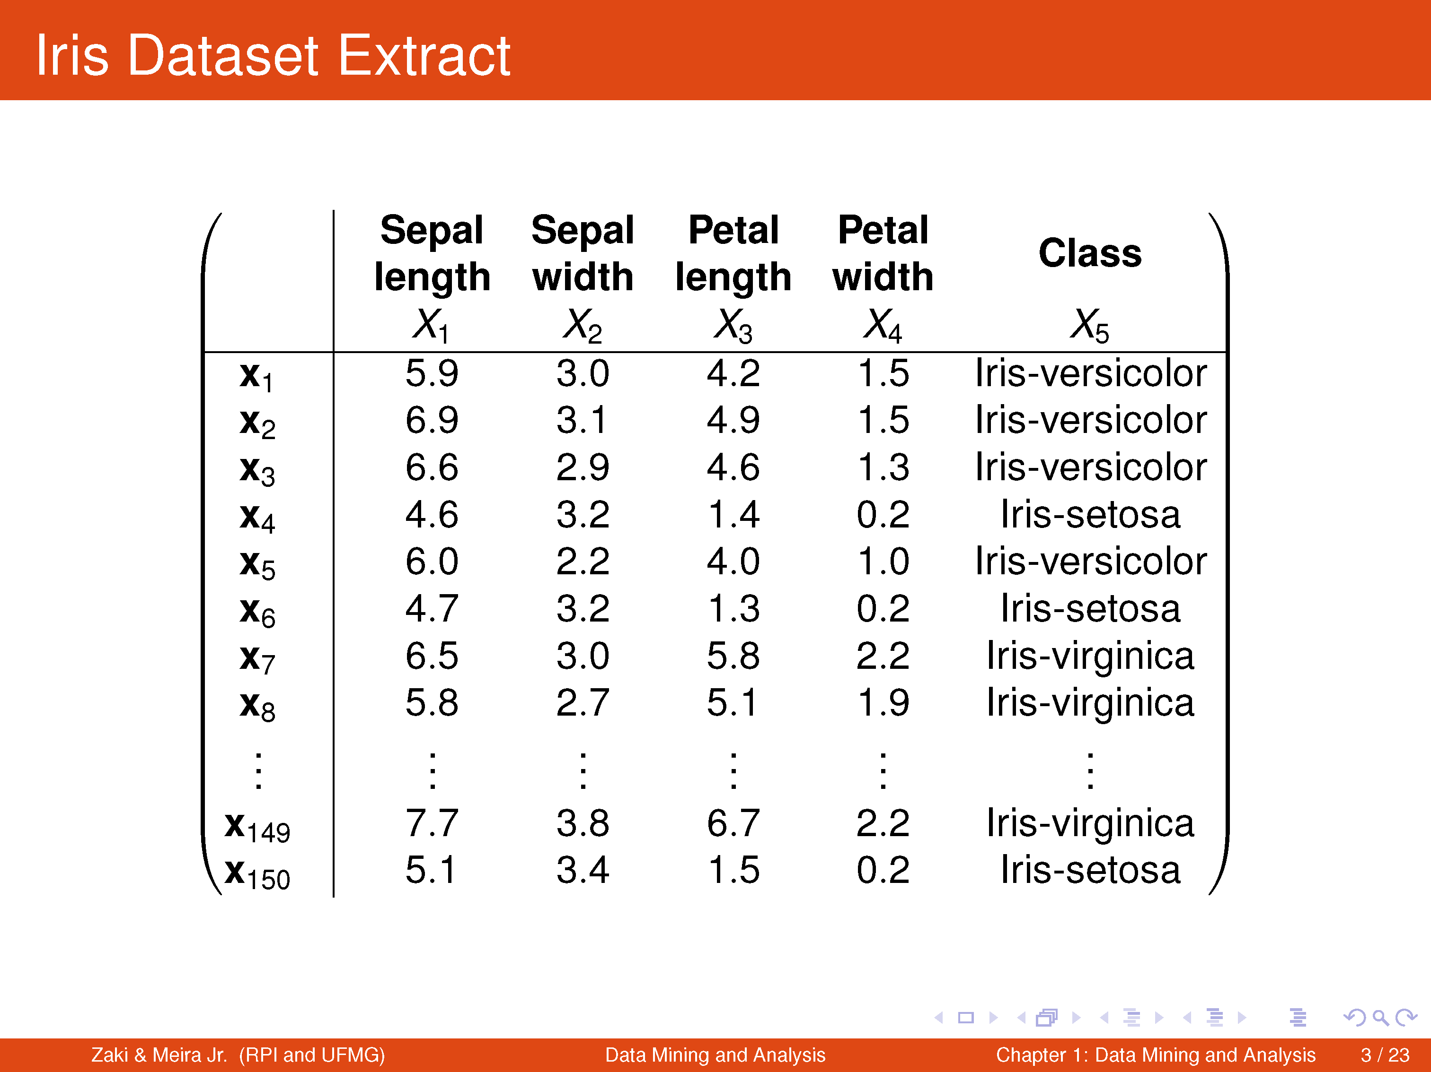

Slide 7
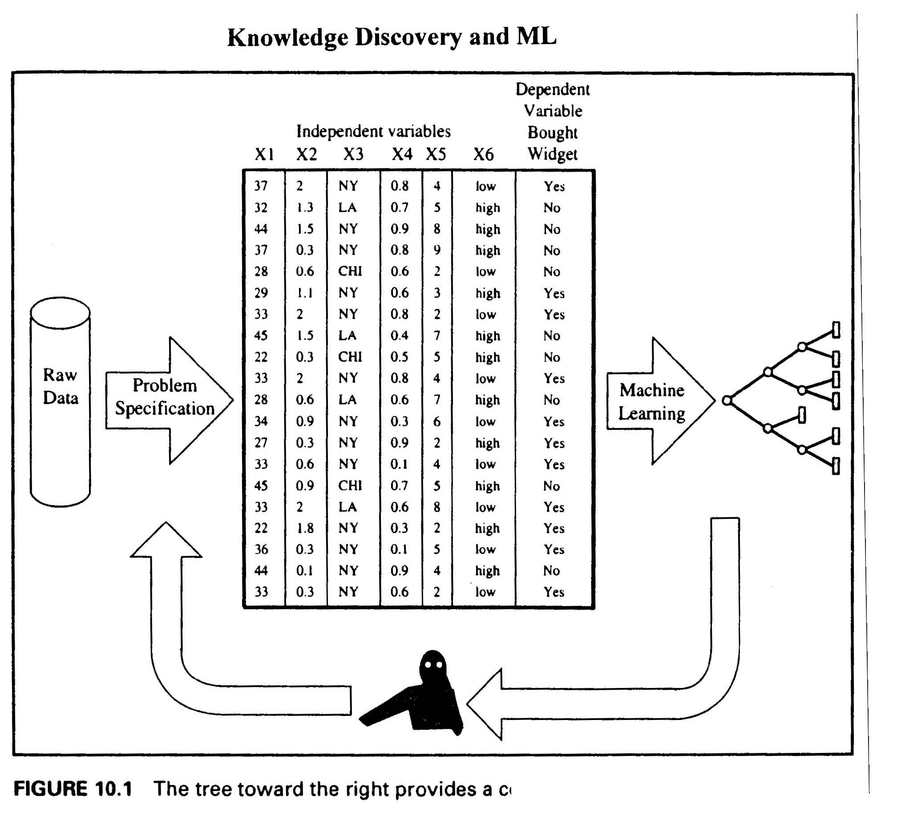
Typical Marketing/Sales Data

Slide 8
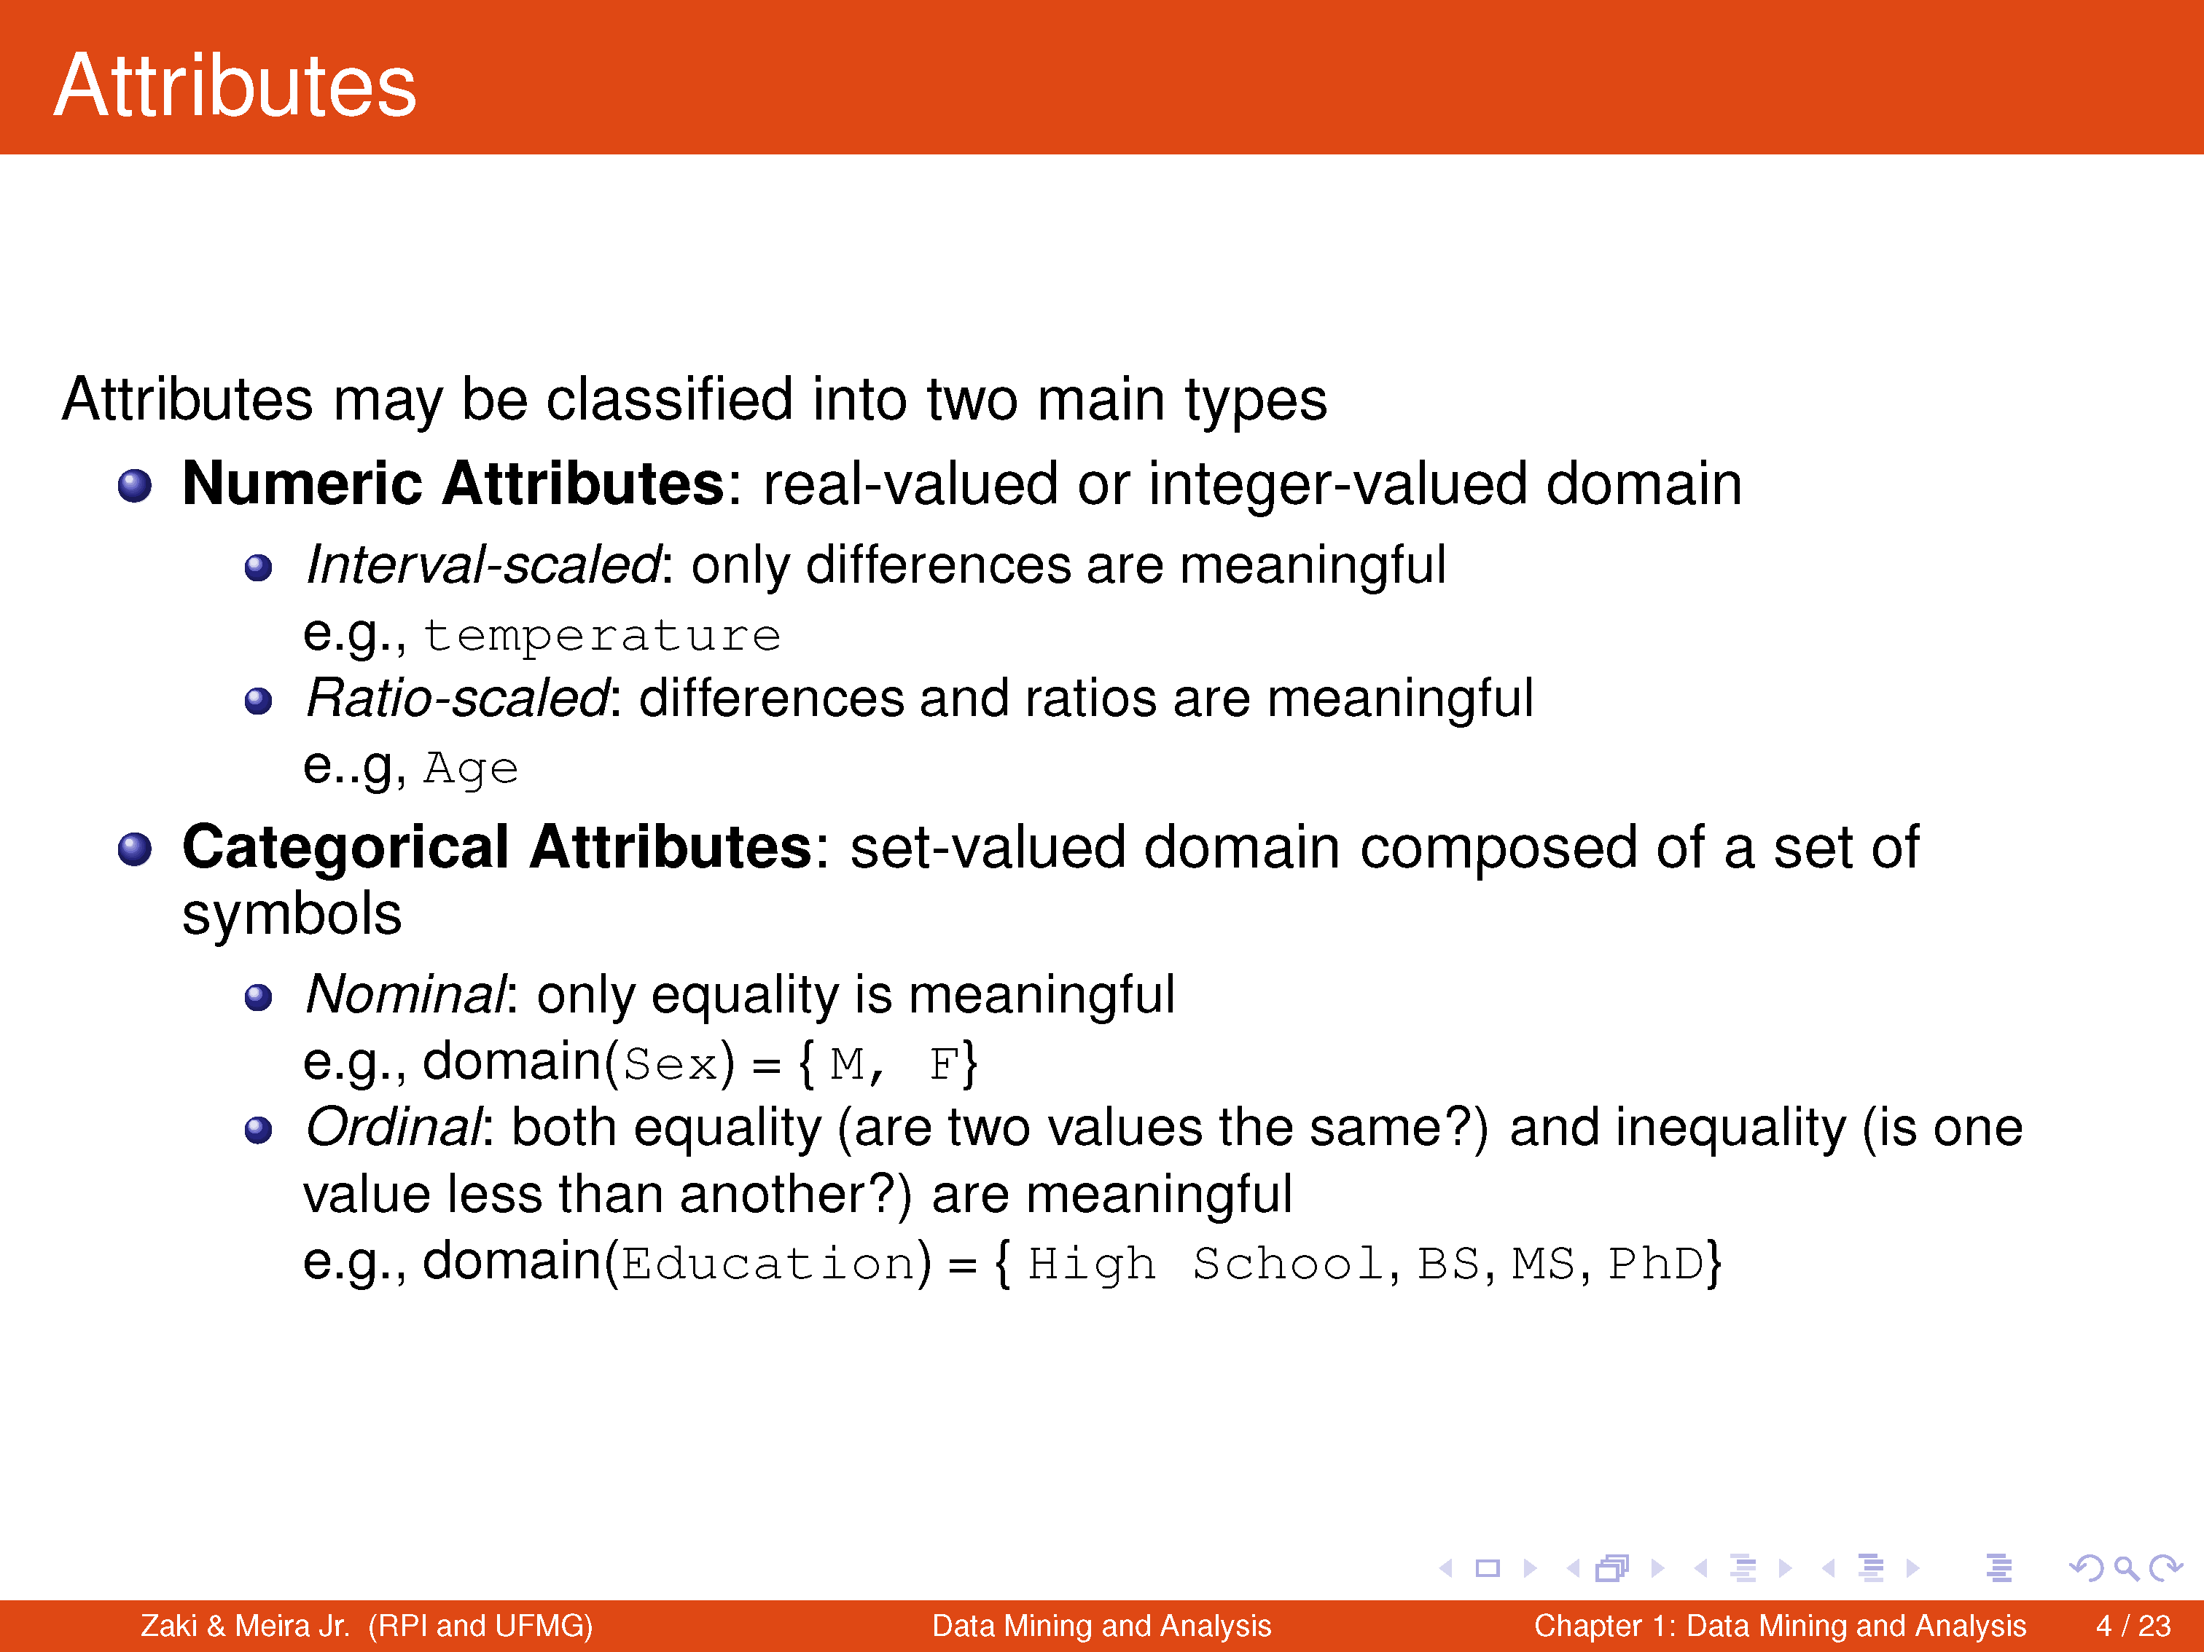

Slide 9
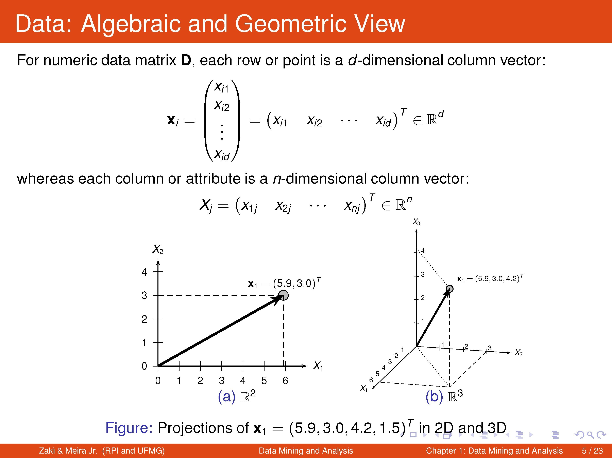

Slide 10
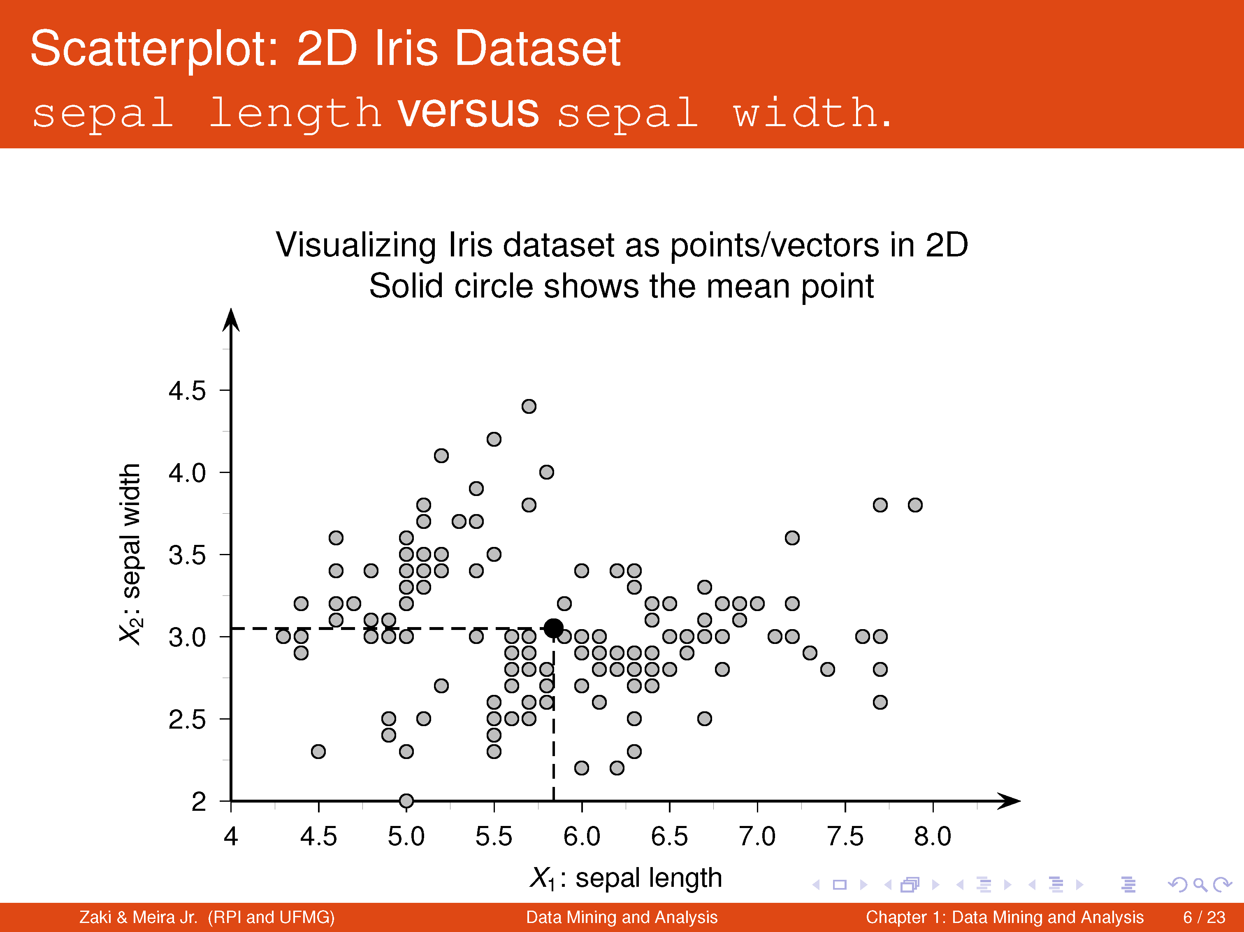

Slide 11
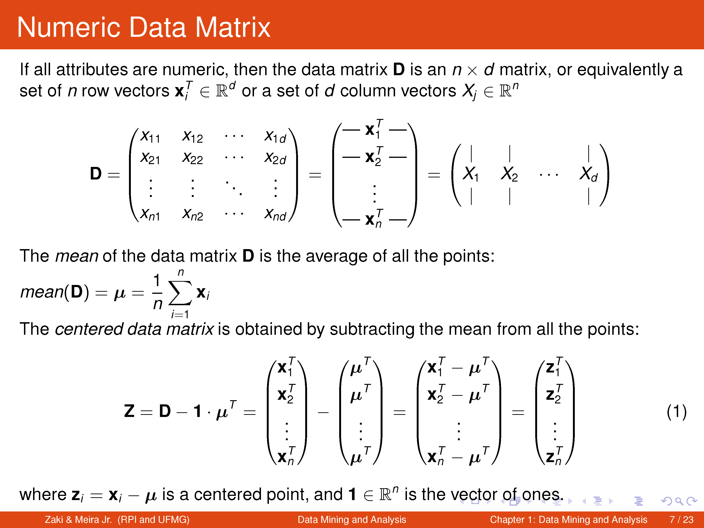

Slide 12
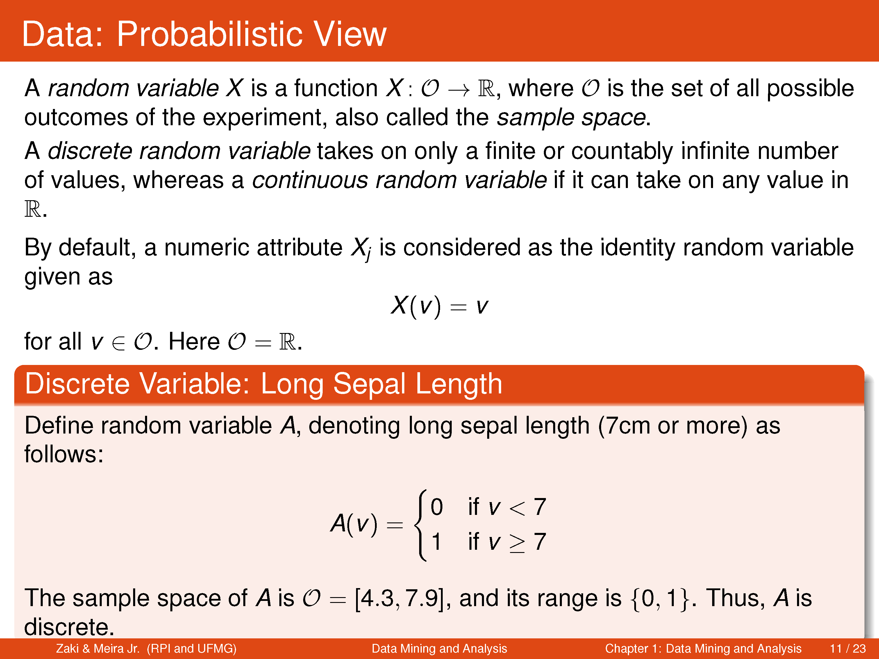

Slide 13


Slide 14
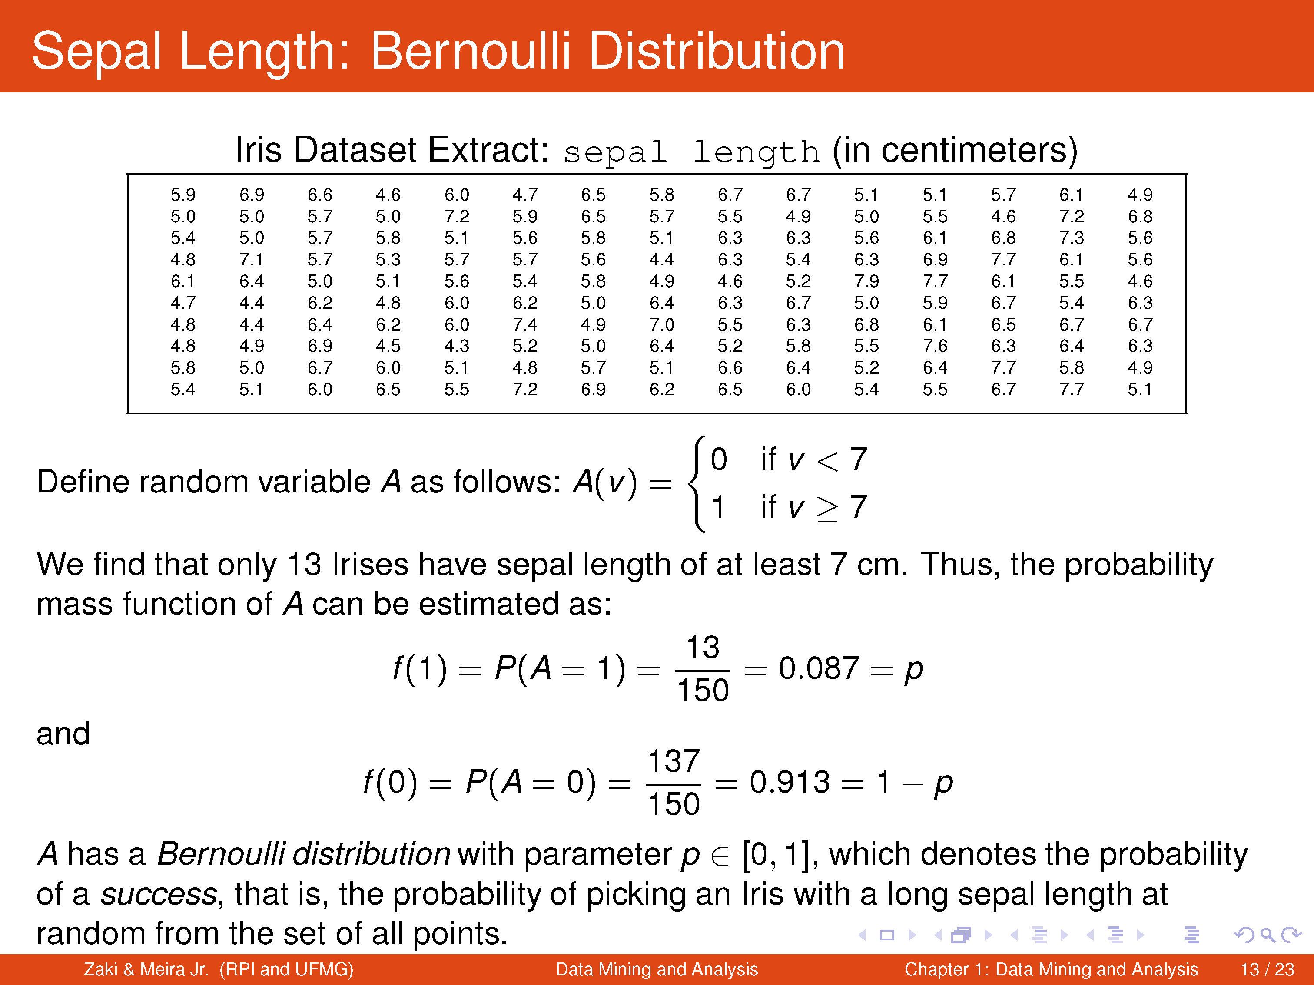

Slide 15
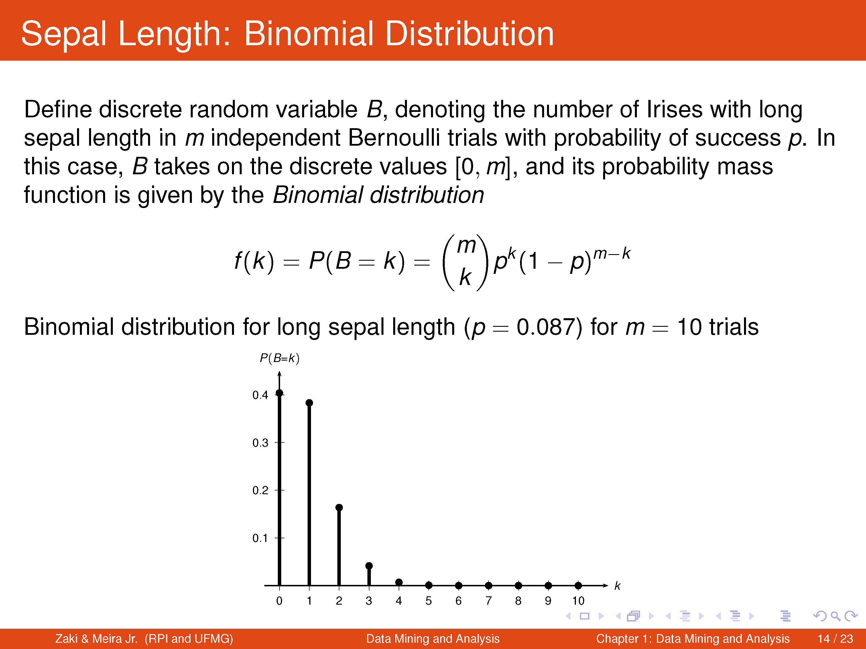

Slide 16


Slide 17
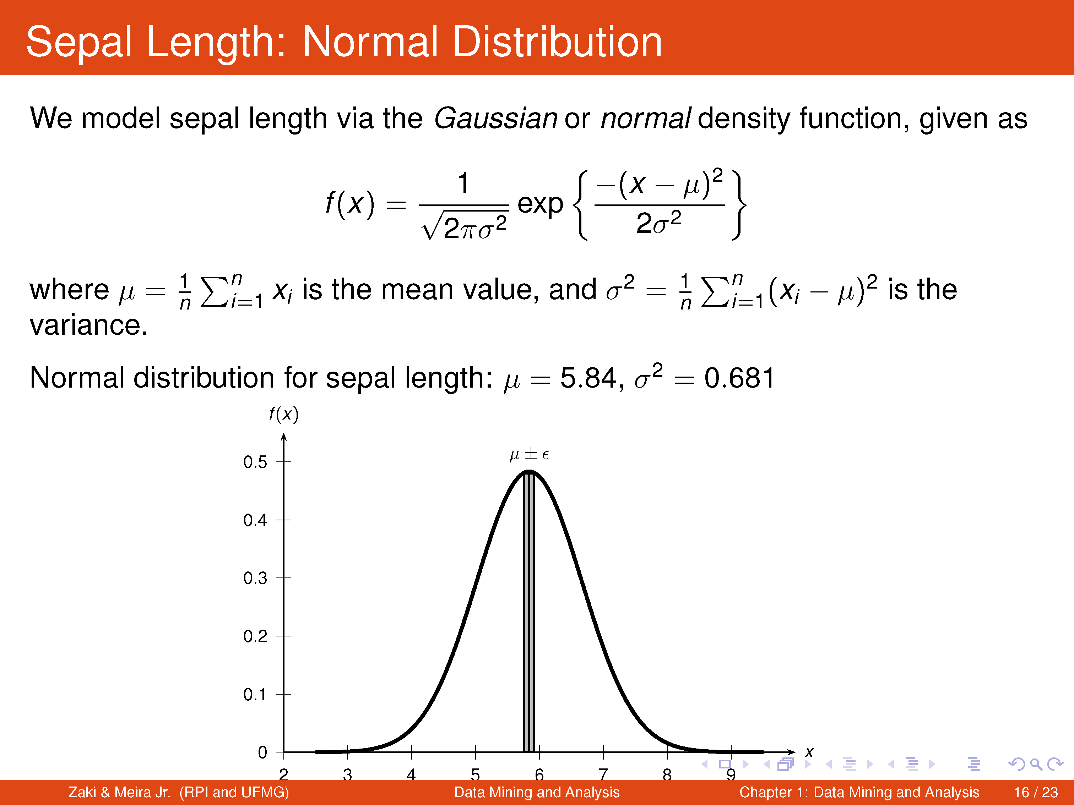

Slide 18
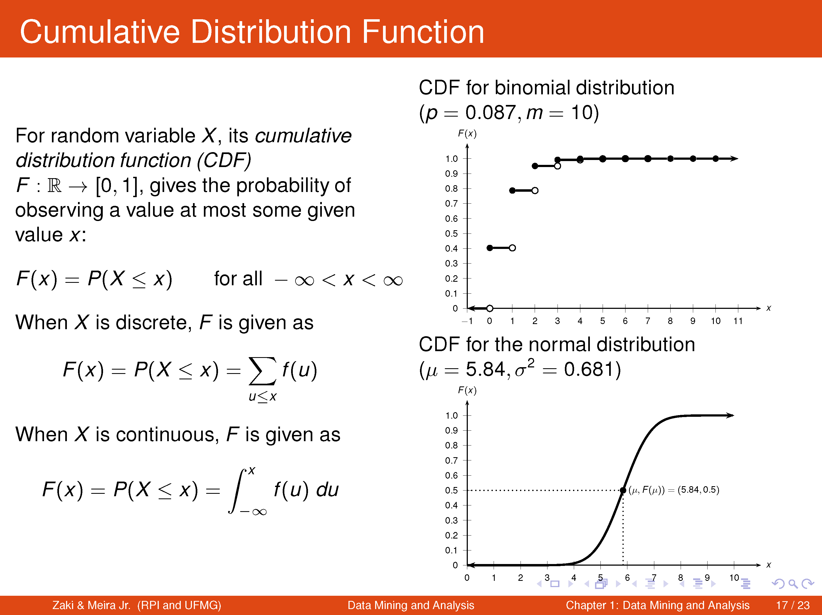

Slide 19
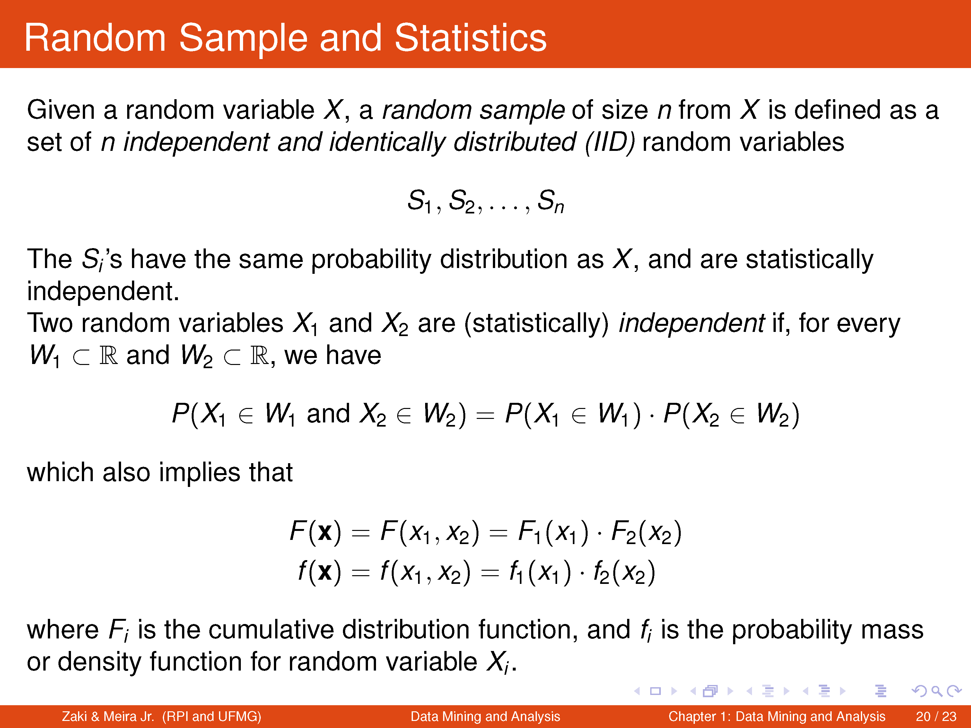

Slide 20
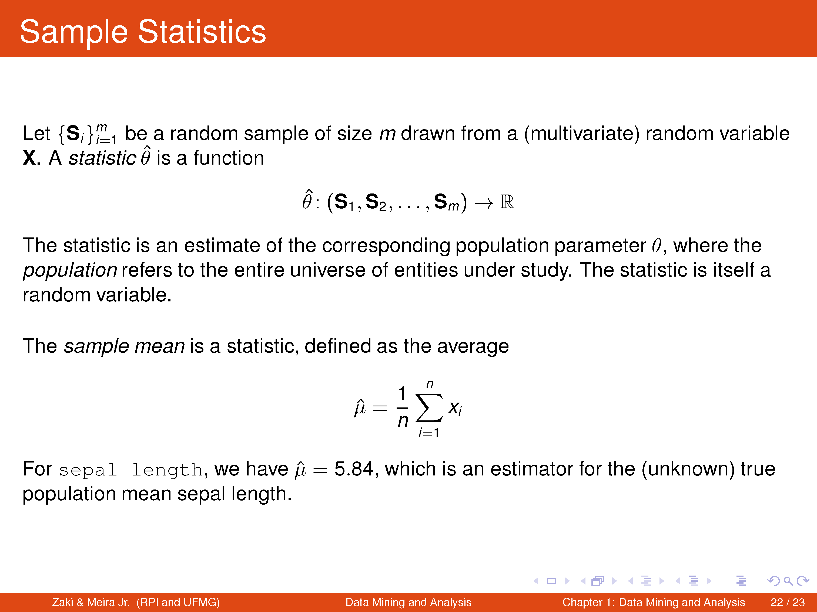

Slide 21
